Slide 1
Random Forest Regressor

Slide 2
Ensemble Learning Model
Ensemble learning is a machine learning technique where multiple models, often referred to as weak learners or base learners, are combined to solve a problem or make predictions.
The primary idea is that a group of models working together can provide better performance than a single model by reducing errors and improving accuracy.

Slide 3
Key Concepts in Ensemble Learning
Weak Learners:
Individual models that perform slightly better than random guessing (e.g., decision trees, linear regressors, etc.).When combined, their predictions lead to significant improvements.
Diversity:
The models used in the ensemble should make different errors or approach the problem in varied ways.
Diversity ensures that the strengths of one model compensate for the weaknesses of others.
Aggregation:
The predictions of all models are aggregated (e.g., through averaging or voting) to produce the final output.

Slide 4
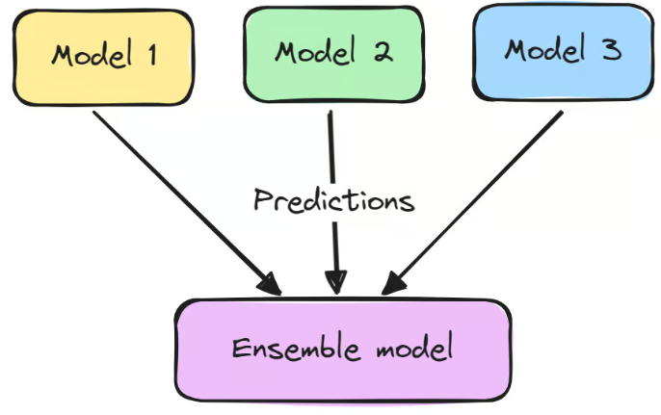

Slide 5
Types of Ensemble Learning Techniques
Bagging (Bootstrap Aggregating):
Improves accuracy by training models on different subsets of the training data, sampled with replacement.
Reduces variance by averaging the predictions of individual models.
Example: Random Forest.
Boosting:
Focuses on correcting the mistakes of previous models by training new models on the errors of earlier ones.
Reduces bias and variance by sequentially improving model performance.
Example: Gradient Boosting, AdaBoost.

Slide 6
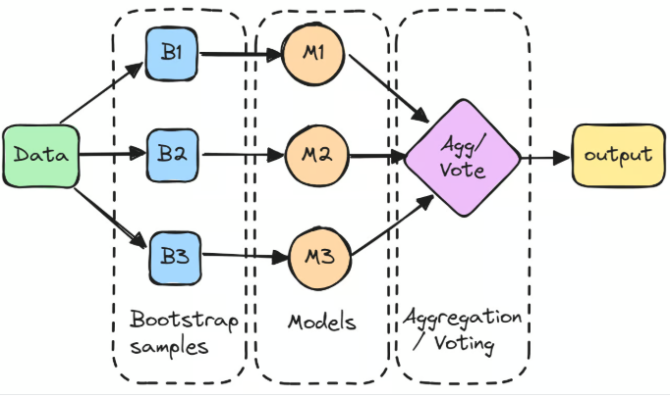
Bagging

Slide 7
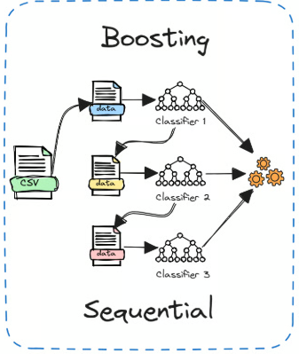

Slide 8
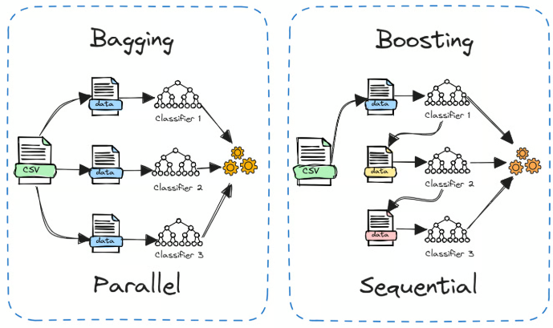

Slide 9
Overview
The Random Forest Regressor is an ensemble learning model for regression tasks.
It predicts numerical values by averaging predictions from multiple decision trees.

Slide 10
Key Concepts
1. Ensemble Learning: Combines multiple models for better results.
2. Decision Tree: Tree-like structure making decisions based on input.
3. Bagging: Trains trees on random data subsets.
4. Feature Randomness: Ensures diverse trees by random feature selection.

Slide 11
How It Works
1. Training Phase:
- Creates multiple decision trees on bootstrapped data.
- Uses random feature subsets for splitting nodes.
2. Prediction Phase:
- Averages predictions from all trees for the final result.

Slide 12
Advantages
1. High Accuracy: Combines multiple trees for better predictions.
2. Robustness: Handles missing values and outliers effectively.
3. Feature Importance: Identifies important features.
4. Non-linearity: Captures complex relationships.

Slide 13
Disadvantages
1. Computational Cost: Resource-intensive with many trees.
2. Interpretability: Harder to interpret compared to a single tree.
3. Bias: Averaging may lead to biased predictions in some cases.

Slide 14
Key Parameters
1. n_estimators: Number of trees.
2. max_features: Features considered for splits.
3. max_depth: Limits tree depth to prevent overfitting.
4. min_samples_split: Minimum samples to split a node.
5. min_samples_leaf: Minimum samples in a leaf node.

Slide 15
Applications
1. Predicting Stock Prices: Forecasting using historical data.
2. Energy Usage Prediction: Estimating electricity consumption.
3. Weather Forecasting: Predicting future weather conditions.
4. Real Estate Valuation: Estimating property prices.

Slide 16
Performance Evaluation Metrics
1. Mean Absolute Error (MAE): Measures average error magnitude.
2. Mean Squared Error (MSE): Penalizes larger errors more.
3. Root Mean Squared Error (RMSE): Square root of MSE.
4. R² Score: Explains variance proportion explained by the model.

Slide 17
Conclusion
The Random Forest Regressor is a powerful tool for regression tasks. It reduces overfitting, captures complex relationships, and delivers robust predictions, making it a popular choice in various domains.

